Slide 1
Slaviša Đurđić
Animal Speed
Goal: Analysis of the Wikipedia free encyclopedia information regarding the fastest animals on earth.
Instructions:
- Collect data from the https://en.wikipedia.org/wiki/Fastest_animals via Power BI Web get data functionality.
- Transform data in Power Query editor.
- Build visuals in Power BI Desktop.
Belgrade, November 2023

Slide 2

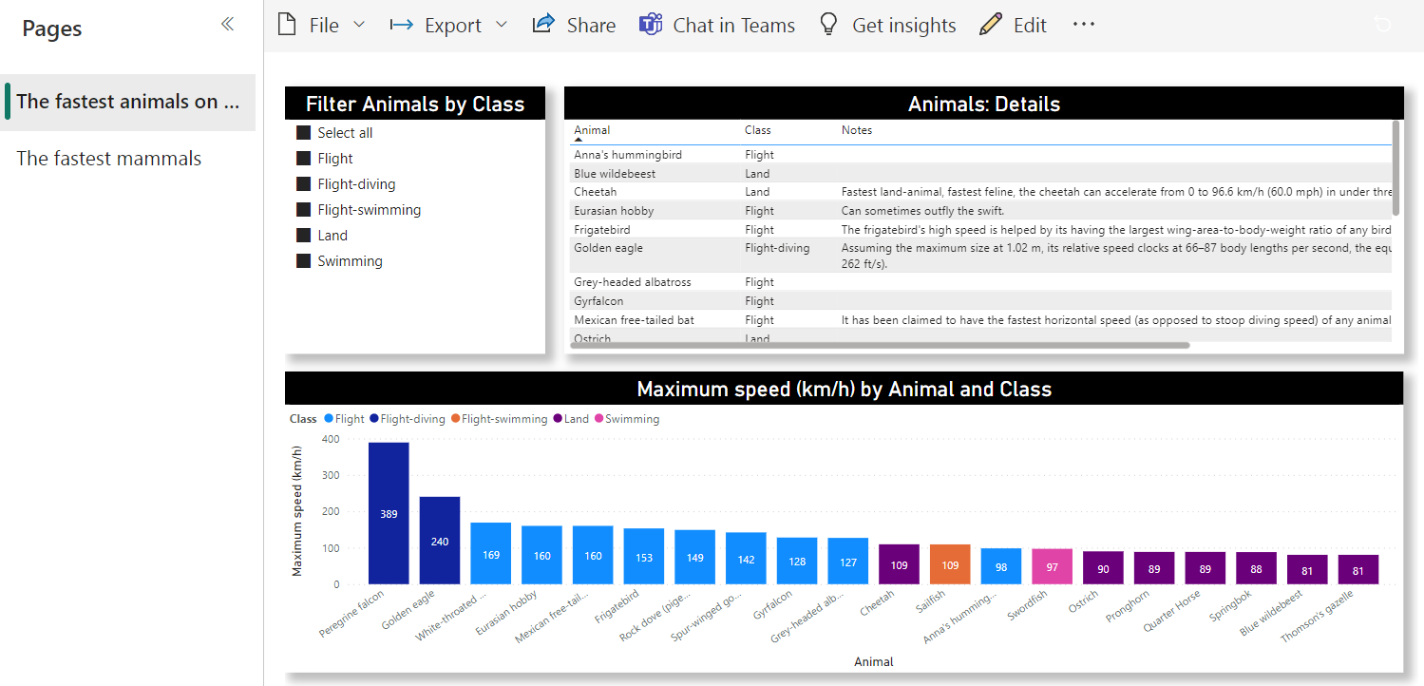
Microsoft Power BI

Slide 3
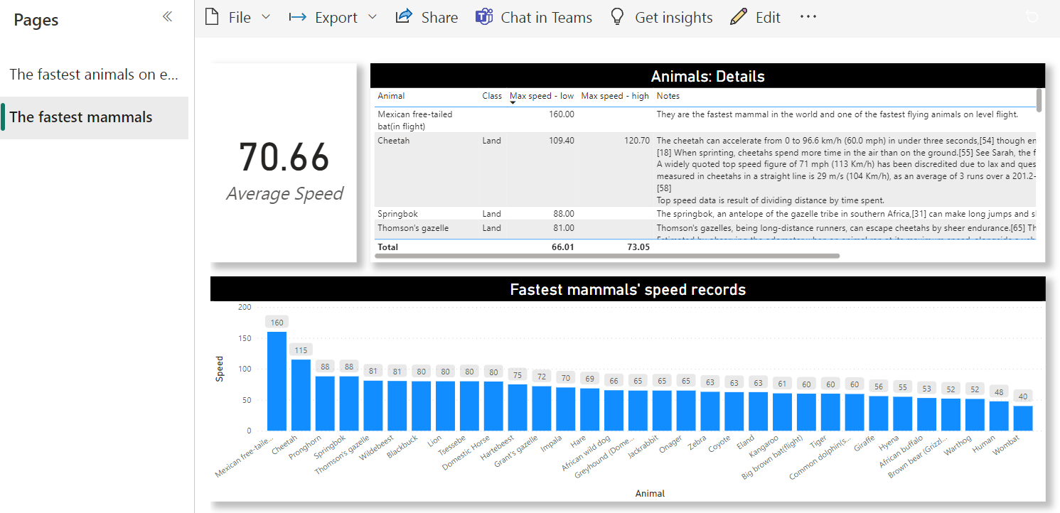
Microsoft Power BI

Slide 4
Animal Speed Project Insights
The fastest animal is Peregrine falcon with the speed of 389 km/h. The peregrine falcon is the fastest aerial animal, fastest animal in flight, fastest bird, and the overall fastest member of the animal kingdom. The peregrine achieves its highest velocity not in horizontal level flight, but during its characteristic hunting stoop (vertical flight). While stooping, the peregrine falcon soars to a great height, then dives steeply at speeds of over 320 km/h (200 mph). Assuming the maximum size at 58 cm, its relative speed clocks at 186 body lengths per second during its hunting swoop, the equivalent of a human running at 170 m/s (560 ft/s).
Overall, the fastest animals are birds (obviously), followed by fish, and finally, land animals.
Average speed of all fastest mammals listed is 70.66 km/h, while Mexican free-tailed bat is the the fastest mammal in the world and one of the fastest flying animals on level flight (160 km/h). The second place takes Cheetah, a land animal, with its average speed of 115 km/h.

